Slide 1

DATA ANALYSIS -
OLIST STORE ANALYSIS
BY - GROUP 1

Slide 2
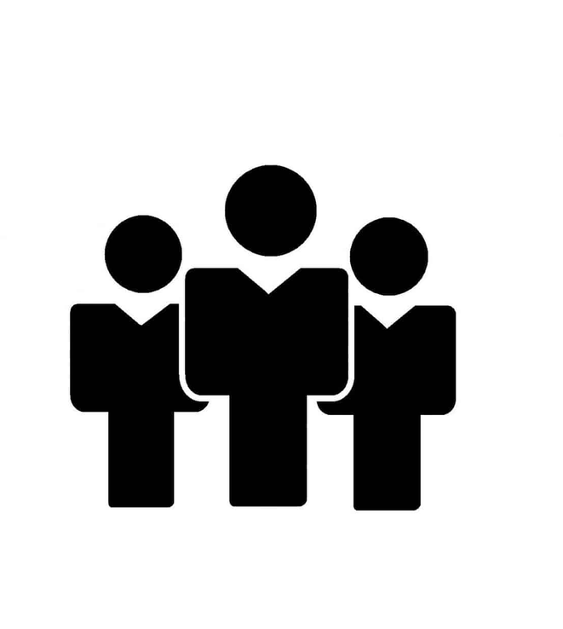
OUR TEAM
Anjali Bhoi
Tushar Gaikwad
Chaittanya Dandekar
Vrushali Bobe
Gajulapalli Rajasekhar Reddy
Pranita Bhagat
Justeena Jose
2014
This space could contain the story
behind your company.
2013
This space could contain the story
behind your company.
2015
This space could contain the story
behind your company.
Pitch Deck
Thynk Unlimited

Slide 3

ABOUT PROJECT
The project assesses the store's sales performance by examining key metrics like revenue growth, average transaction value, conversion rates, and customer retention.
The project evaluates the impact of the store on customer experience and satisfaction.By understanding customer preferences, the project helps optimize the store's offerings to enhance the overall experience.
The project analyzes the different payment modes accepted by the store. By examining customer payment habits, the project seeks to identify the preferred payment modes among the target audience.
Through the analysis of operational efficiency, inventory management, and cost control measures, the project aims to streamline operations and reduce expenses.
The project also evaluates the performance of the store across different cities or geographical locations. This analysis provides insights into customer behavior, preferences, and demands specific to each city, enabling the store to customize its strategies and offerings accordingly..
The project assesses the store's operational efficiency by analyzing aspects such as inventory management, supply chain logistics, staff productivity, and cost control measures.

Slide 4

Effects : The project aims to uncover the various effects that the retail store has on business operations.
Sales revenue
Customer satisfaction
Brand image
Overall market position.
Causes : By conducting a thorough analysis, the project aims to identify the underlying causes behind the effects
Store layout
Product placement
Pricing strategies
Inventory management
Business Objective :
The Olist store analysis project focuses on understanding the effects and causes of store’s performance while aiming to improve business profit.
By evaluating sales performance, customer experience, competitive advantage, operational efficiency, and marketing effectiveness.

Slide 5
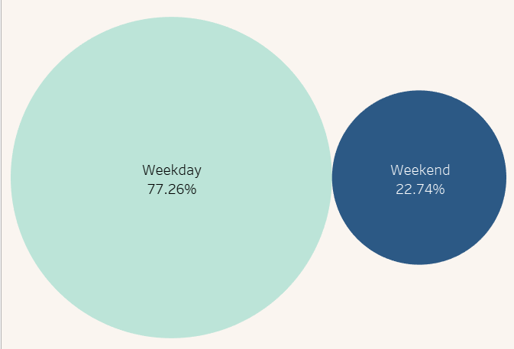
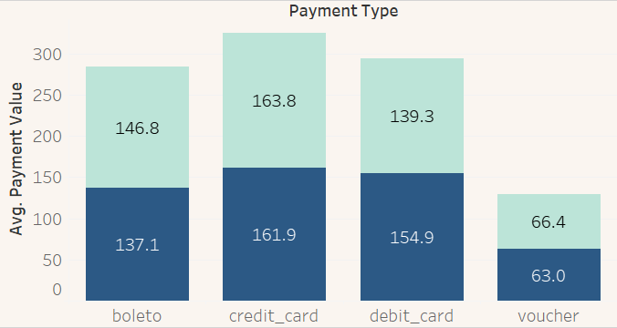
KPI 1
Total payment has been dropping, with weekends having the fewest orders. This indicates that Saturdays and Sundays are less active and have fewer purchases than weekdays.
The number of shipment days has been decreasing. Because fewer orders are placed on weekends, the demand for shipping is minimised, resulting in fewer days allocated to order fulfilment.
Weekends seem to generate less profit compared to weekdays, with Tuesdays being the most profitable day. This indicates that customers are more inclined to make purchases on weekdays, possibly due to factors such as work routines, availability of promotions, or higher foot traffic in physical stores.
Based on the data above, it is best to concentrate on growing weekend sales by capturing customers' attention and persuading them to buy more on Saturdays and Sundays. Targeted advertising, weekend-specific discounts, or emphasising weekend-exclusive products may help drive sales during these generally sluggish days.
24/7 Accessibility
Hybrid Cloud Service

Slide 6
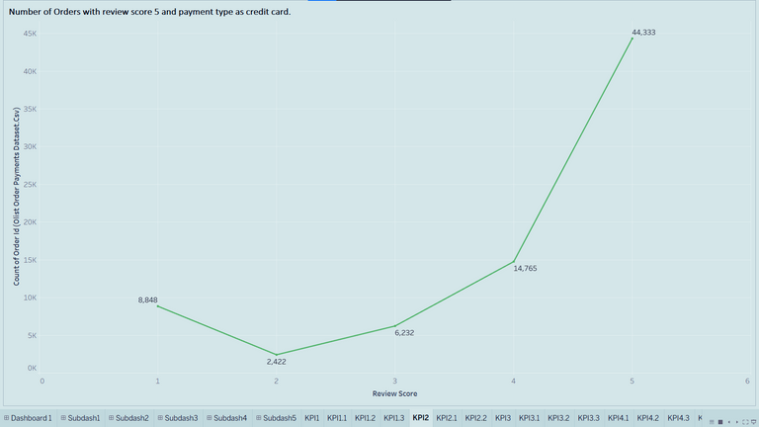
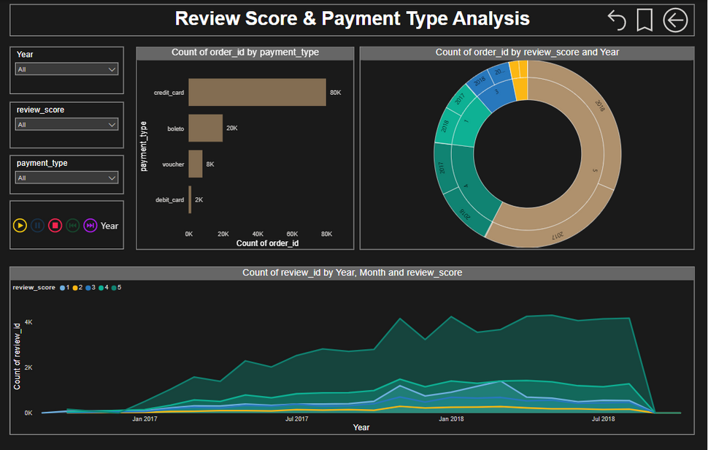
Number of orders with review score 5 and payment type as credit card are 44333.
There is significant growth in number of orders on yearly basis. Number of orders are maximum in 2018
Most customers are preferring credit card as payment type. Total payment value received is maximum from payment type credit card i.e. nearly 78% of total payment
Products having maximum number of orders are cama_mesa_banho, beleza_saude, esporte_lazer, moveis_decoracao and informatica_acessorios
Nearly 57% orders are for products with review score 5. We have to improve quality of products so that customer review score will increase and therefore number of orders will also increase
KPI 2

Slide 7
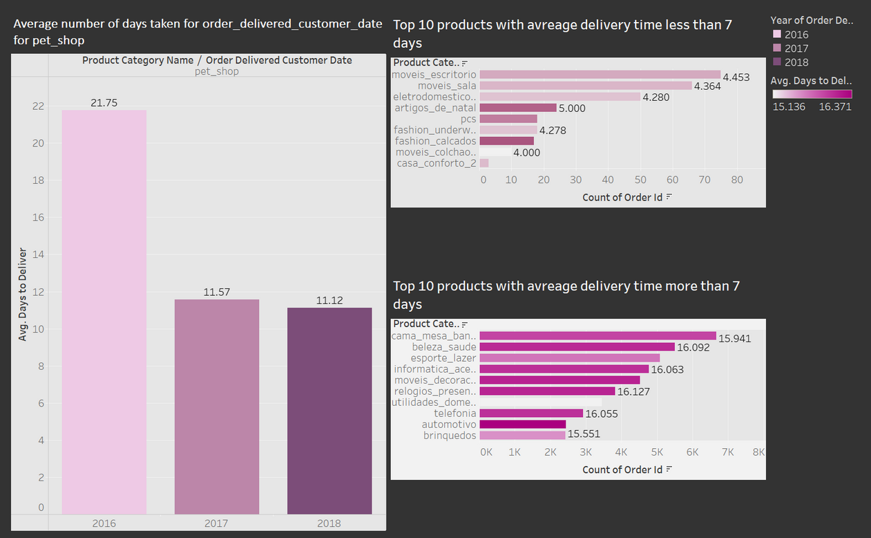
KPI 3
Average number of days to deliver the order for pet shop is 11 days.
A smaller average number of days suggests a more rapid and efficient order delivery process, which is often preferred by both customers and businesses. It suggests that the organisation can process and ship orders quickly, ensuring customer satisfaction and potentially encouraging repeat business.
A larger average number of days, on the other hand, indicates delays or inefficiencies in the order fulfilment process. This could lead to customer discontent, unfavourable reviews, and an increase in returns or cancellations. Identifying and addressing the reasons that cause delays is critical for improving customer experience and maintaining a competitive edge in the market.

Slide 8
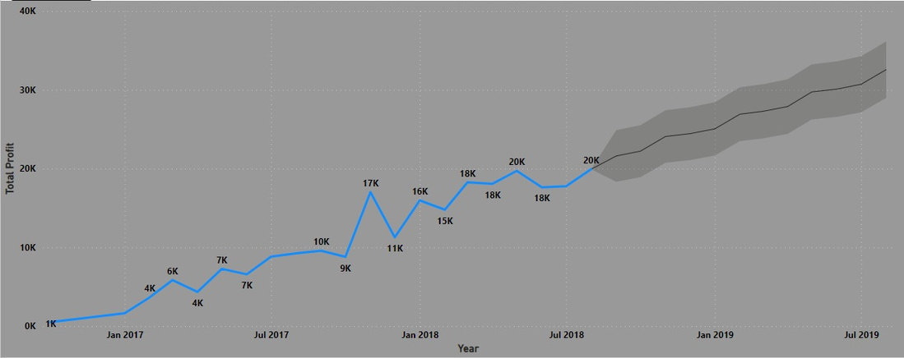
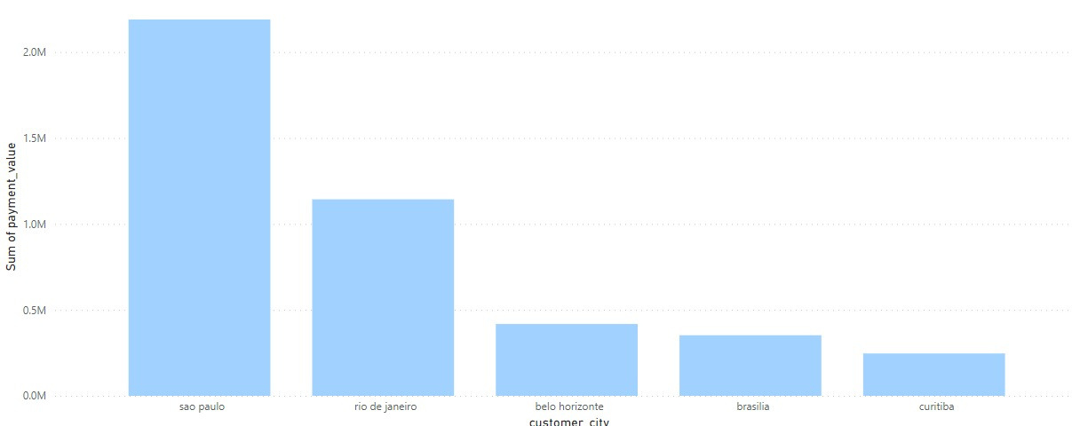
KPI 4
In terms of average sales amount for most purchased products, Sao Paulo city ranks in the top five cities. As a result, Sao Paulo's total profit is expected to be high in comparison to other cities.
According to the data supplied, Sao Paulo's total profit in July 2018 was 19,921.68. The entire profit is expected to climb to roughly 32,572.78 by August 2019. This indicates that profit will increase significantly over the selected time period.
According to the statement, item pricing remained mostly steady between 2017 and 2018, with modest modifications. However, despite these slight price swings, there was little impact on product demand. This implies that demand remained consistent despite minor price increases.
Based on the information supplied, if demand for items in Sao Paulo city has stayed stable despite modest price fluctuations in the past, demand is anticipated to increase in the coming year as well. However, it is vital to highlight that other factors, such as changes in consumer tastes, economic conditions, or market rivalry, could influence demand.

Slide 9
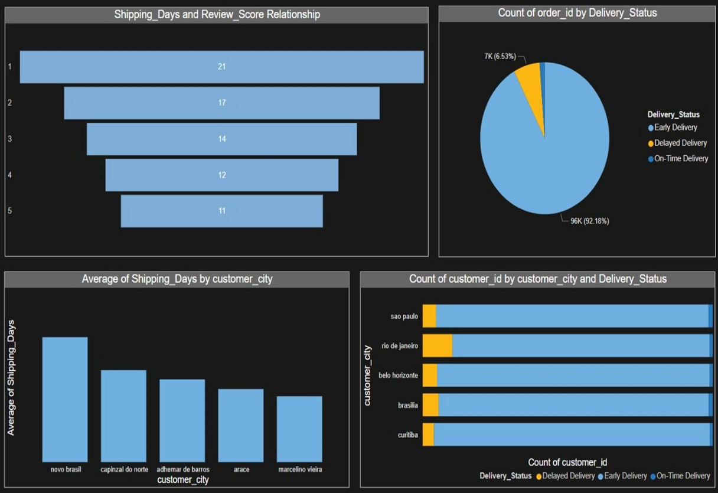
KPI 5
This KPI examines the association between review scores and shipping time. This shows that the overall delivery procedure is highly efficient, with the majority of consumers receiving their items ahead of schedule. However, around 7% of purchases encountered delivery delays, underscoring the need to address this issue and reduce the number of delayed deliveries even further.
Rio de Janeiro and Brasilia had the greatest rates of delivery delays among the top consumer cities. This research shows that certain locations may be experiencing logistical or operational issues, resulting in greater rates of delivery delays. Addressing these issues in these specific regions can increase overall delivery performance and customer satisfaction dramatically.
The cities of Novo Brasil, Capinzal do Norte, Adhemar de Barros, Aracê, and Marcelino Vieira had the shortest shipping times. Furthermore, these cities received a small number of orders. Longer shipping periods and low order quantities in these cities may suggest logistical difficulties, limited transportation alternatives, or other reasons that lead to delayed deliveries. Analysing and resolving the underlying problems can aid in decreasing shipment times and increasing order volumes in certain places.

Slide 10
CONCLUSION
1st KPI :- Customer behavior and preferences can be gained by analyzing payment statistics based on weekdays and weekends.
2nd KPI :- Customer satisfaction and preferred payment methods are indicated by the number of orders with reviews of five stars and credit card payments. It implies that customers are more likely to leave favorable evaluations when they pay with a credit card..
3rd KPI :- Customers of pet stores can learn about the effectiveness and speed of the delivery process by looking at the typical number of days it takes to fulfil their orders. It can be used to assess the efficiency of the delivery and logistics teams, spot bottlenecks, and raise client satisfaction.
4th KPI :- The purchasing power and spending habits of this particular client niche can be better understood by looking at the average pricing and payment values from customers in So Paulo city. It can be applied to targeted marketing plans and selection of product prices.
5th KPI :- In order to optimise the delivery process and raise customer happiness, it can be used to determine whether faster or slower shipping affects consumer perception and review scores.
Finally, the Olist Store Analysis project should concentrate on comprehending client spending habits, delivery effectiveness, customer contentment, and payment preferences. Businesses may improve their offerings, streamline operations, and improve client experiences by considering five crucial indicators.

Slide 11
Thank You

